Slide 1
Level 4_5 – Group 7
George Heath-Collins, Brad Pablo, Katie Millar and George Croucher

Slide 2
Feedback from the previous iteration
It isn’t clear who has won.
It’s hard to keep track of who is in the lead.
The game doesn’t get more difficult.
Player 1 starts with an advantage.

Slide 3
Feedback from the previous iteration
Trees do not fall over.
Player UI covers the gauge on the screen.
The comeback cursor is too easy to hit.

Slide 4
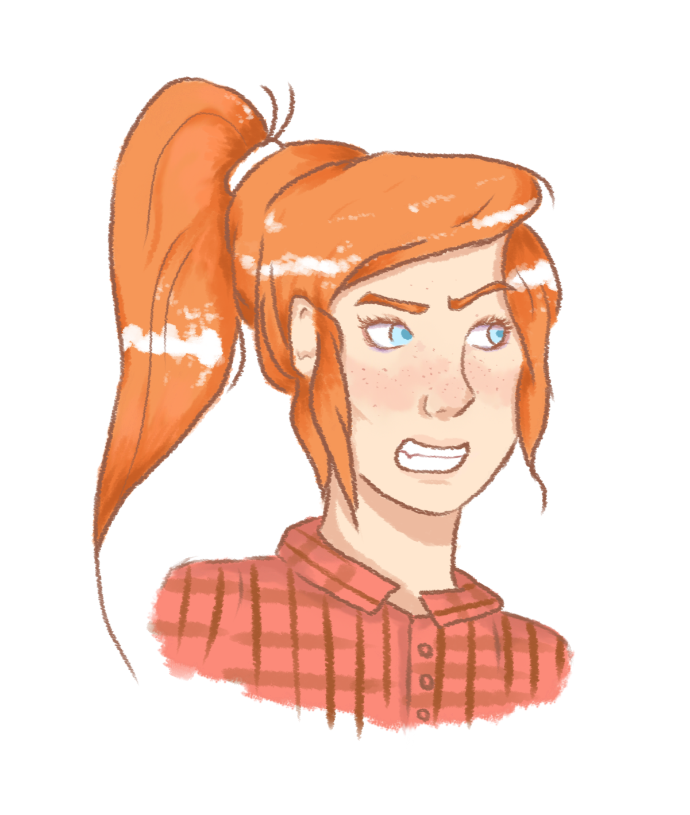
The latest version

Slide 5
How has the game been iterated?
A focus on visual feedback.
‘Sweet-spot’ system instead of a Power bar.
One player uses the phone at a time.
Comeback system for more skilled players.
Less intrusive UI.
An increasing difficulty system.

Slide 6
Programming Lessons learned
How to use Git, especially with Unreal.
UI in Unreal – incl. animations.
Communications between Blueprint Classes.
Using multiple levels.
Using functions in Blueprint.
Certain flow control nodes.

Slide 7
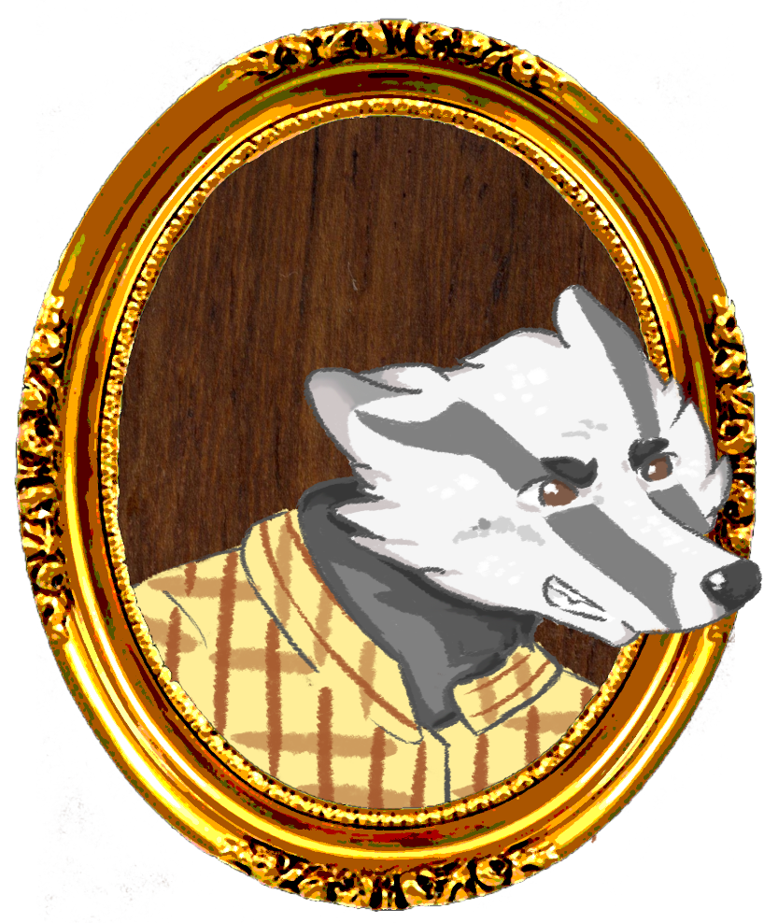
Design Lesson Learned
Conveying concepts clearly is important.
Sometimes a simpler, cleaner art style is better than over-complicating things.
Be more open-minded in reworking core mechanics when something isn’t working. Don’t be precious with ideas.
Letting your team know that you don’t know how to proceed is better than winging it and producing something sub-par.

Slide 8
Management Lessons learned
Regular Communication to combat confusion.
Time management is essential.
Back up plans are necessary.
Utilise user feedback to shape the projects direction.

Slide 9
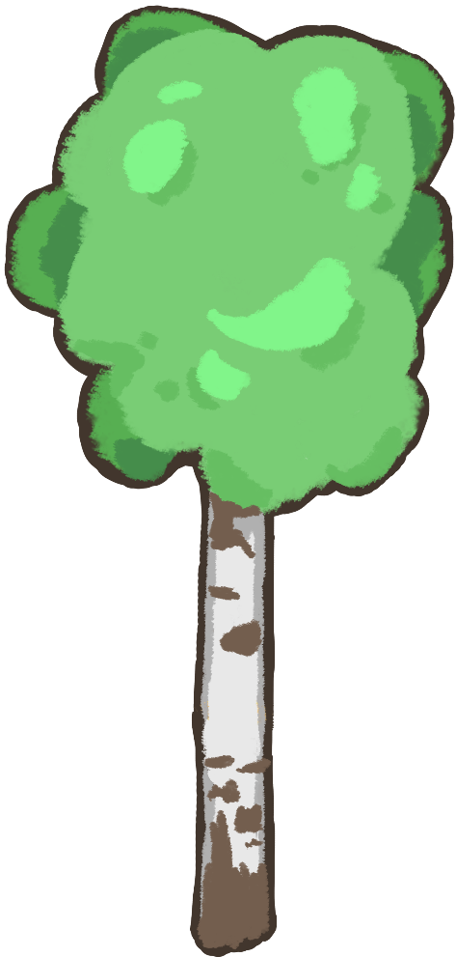
Thanks for listening

